Slide 1
Circular Queues and Double ended Queues

Slide 2
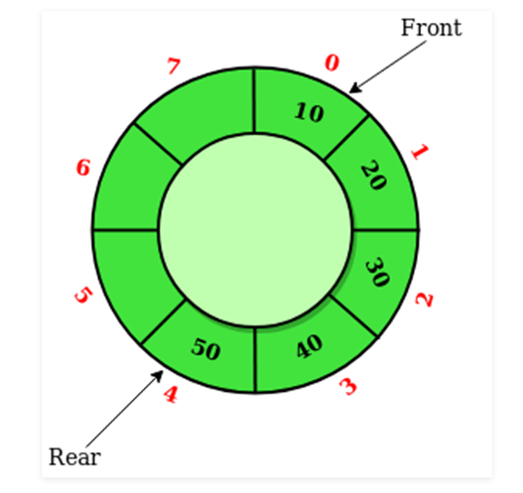
Circular Queue
Circular Queue is a linear data structure in which the operations are performed based on FIFO (First In First Out) principle and the last position is connected back to the first position to make a circle.

Slide 3
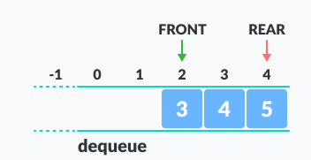
Circular queue avoids the wastage of space in arrays.

Slide 4
How Circular Queue Works ?
Circular Queue works by the process of circular increment i.e. when we try to increment the pointer and we reach the end of the queue, we start from the beginning of the queue.
Here, the circular increment is performed by modulo division with the queue size. That is,
if REAR + 1 == 5 (overflow!),
REAR = (REAR + 1)%5 = 0 (start of queue)

Slide 5
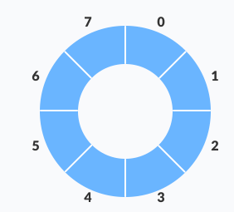
Circular Queue Operations
The circular queue work as follows:
Two pointers FRONT and REAR
FRONT track the first element of the queue
REAR track the last elements of the queue
initially, set value of FRONT and REAR to -1

Slide 6
Enqueue Operation:
Check if the Queue is full
for the first element, set value of FRONT to 0
Circularly increase the REAR index by 1 (i.e. if the rear reaches the end, next it would be at the start of the queue)
Add the new element in the position pointed to by REAR

Slide 7
Dequeue Operation:
Check if the Queue is empty
return the value pointed by FRONT
Circularly increase the FRONT index by 1
If it is the Last element, reset the values of FRONT and REAR to -1

Slide 8
However, the check for full queue has a new additional case:
Case 1: FRONT = 0 && REAR == SIZE - 1
Case 2: FRONT = REAR + 1
The second case happens when REAR starts from 0 due to circular increment and when its value is just 1 less than FRONT, the queue is full.

Slide 9
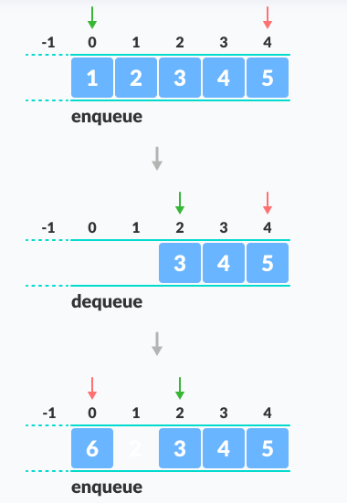
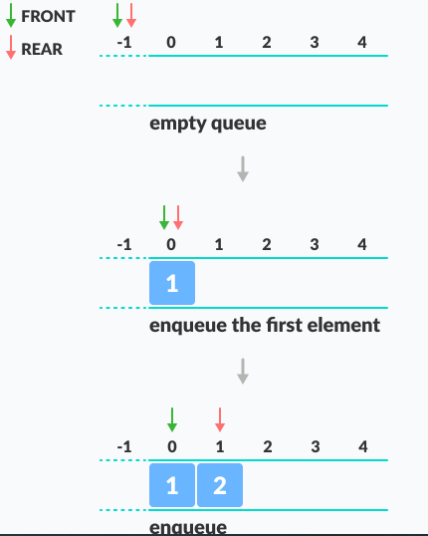
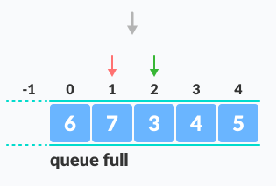

Slide 10
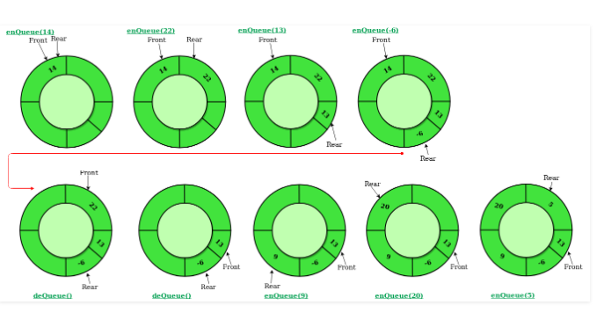

Slide 11
// Circular Queue implementation in C
#include <stdio.h>
#define SIZE 5
int items[SIZE];
int front = -1, rear = -1;
// Check if the queue is full
int isFull() {
if ((front == rear + 1) || (front == 0 && rear == SIZE - 1))
return 1;
return 0;
}
// Check if the queue is empty
int isEmpty() {
if (front == -1) return 1;
return 0;
}

Slide 12
// Adding an element
void enQueue(int element) {
if (isFull())
printf("\n Queue is full!! \n");
else {
if (front == -1)
front = 0;
rear = (rear + 1) % SIZE;
items[rear] = element;
printf("\n Inserted -> %d", element);
}
}

Slide 13
// Removing an element
int deQueue() {
int element;
if (isEmpty())
{ printf("\n Queue is empty !! \n"); return (-1);
}
else
{ element = items[front];
if (front == rear) /* one element */
{ front = -1; // Q has only one element, so we reset the queue
rear = -1; // after dequeing it.
}
else
{ front = (front + 1) % SIZE; }
printf("\n Deleted element -> %d \n", element);
return (element);
}
}

Slide 14
// Display the queue
void display()
{ int i;
if (isEmpty())
printf(" \n Empty Queue\n");
else
{ printf("\n Front -> %d ", front);
printf("\n Items -> ");
for (i = front; i != rear; i = (i + 1) % SIZE) {
printf("%d ", items[i]);
}
printf("%d ", items[i]);
printf("\n Rear -> %d \n", rear);
}
}

Slide 15
int main() {
// Fails because front = -1
deQueue(); enQueue(1);
enQueue(2); enQueue(3);
enQueue(4); enQueue(5);
// Fails to enqueue because front == 0 && rear == SIZE - 1
enQueue(6);
display();
deQueue();
display();
enQueue(7);
display();
// Fails to enqueue because front == rear + 1
enQueue(8);
return 0; } }

Slide 16
Narrate the following operations in a circular queue of size 9. Show the status of circular queue for each of the print operation
for (int k = 0; k <= 8; k++)
printf(enqueue(k));
for (int k = 0; k < 5; k++)
{
printf(enqueue(dequeue()));
printf(dequeue());
printf(dequeue());
}

Slide 17
With neat diagrams represent all the following operations on a queue of size 5.
Justify the output after each operation
dequeue(),
enqueue(X),
enqueue(B),
dequeue(),
enqueue(K),
display(),
dequeue(),
display()

Slide 18
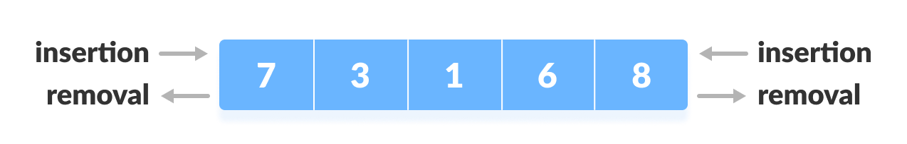
Double Ended Queues
Deque or Double Ended Queue is a type of queue in which insertion and removal of elements can be performed from either from the front or rear. Thus, it does not follow FIFO rule (First In First Out).

Slide 19
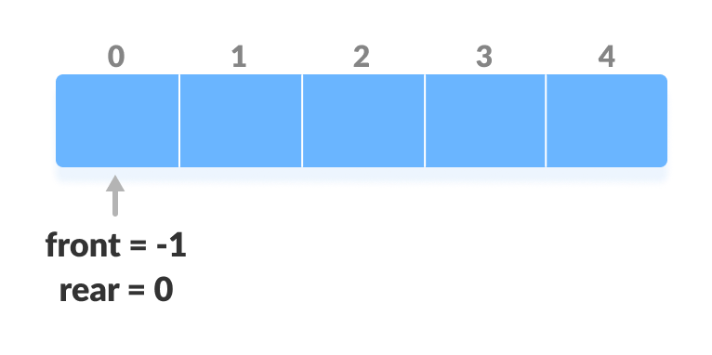
Operations on a Deque
In a circular array, if the array is full, we start from the beginning.
But in a linear array implementation, if the array is full, no more elements can be inserted. In each of the operations below, if the array is full, "overflow message" is thrown.
Before performing the following operations, these steps are followed.
Take an array (deque) of size n.
Set two pointers at the first position and set front = -1 and rear = 0.

Slide 20
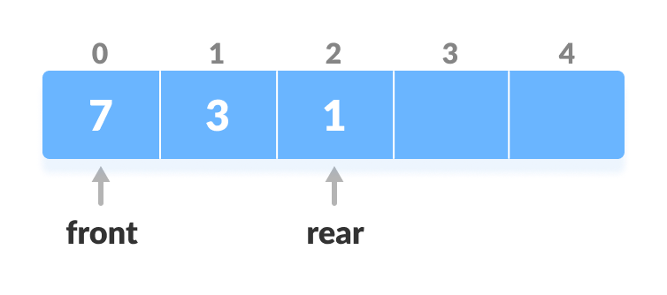
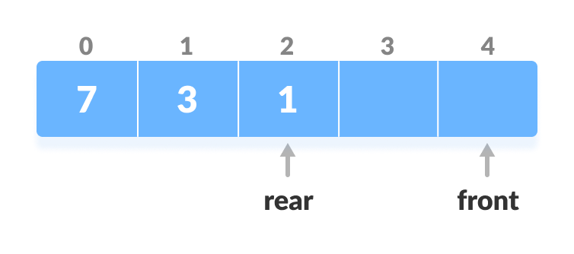
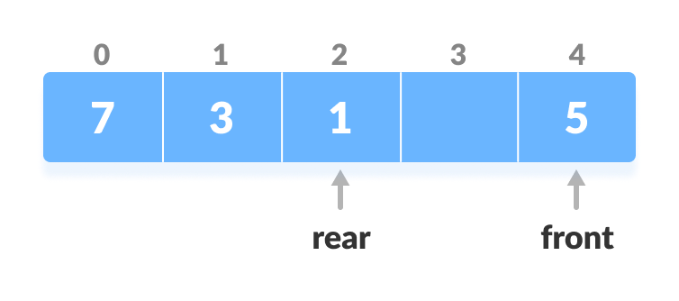
1. Insert at the Front
This operation adds an element at the front.
Check the position of front
2. If front < 1, reinitialize front = n-1 (last index).
Shift front to the end
3. Else, decrease front by 1.
Add the new key 5 into array[front].
Insert the element at Front

Slide 21
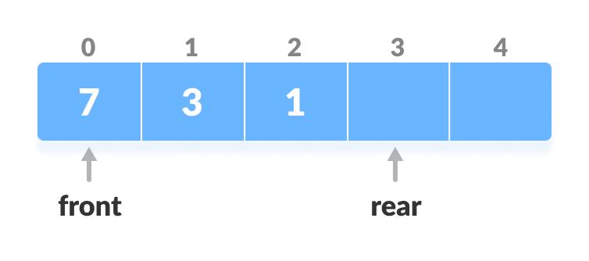
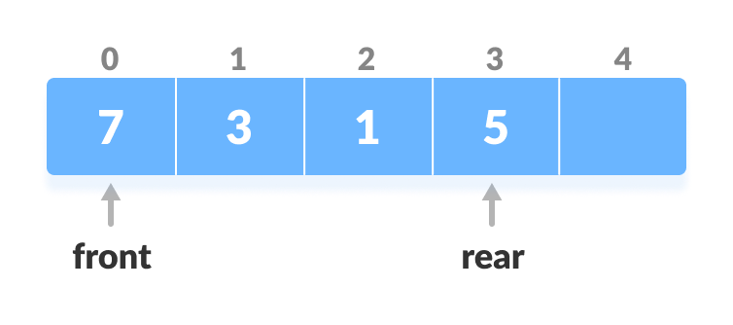
2. Insert at the Rear
This operation adds an element to the rear.
1. Check if the array is full
Check if deque is full
2. If the deque is full, reinitialize rear = 0.
3. Else, increase rear by 1
Increase the rear
4. Add the new key 5 into array[rear]
Insert the element at rear

Slide 22
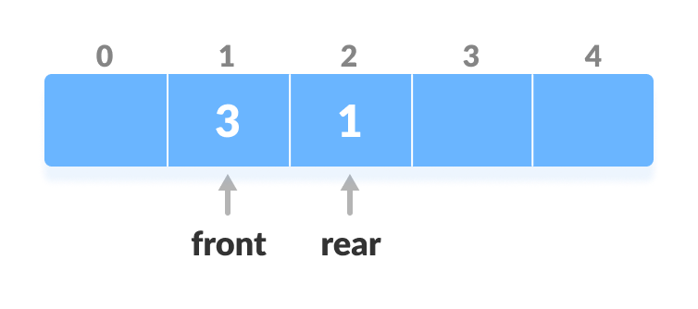
3. Delete from the Front
The operation deletes an element from the front.
1. Check if the deque is empty.
Check if deque is empty
2. If the deque is empty (i.e. front = -1), deletion cannot be performed (underflow condition).
3. If the deque has only one element (i.e. front = rear), set
front = -1 and rear = -1.
4. Else if front is at the end (i.e. front = n - 1), set go to the front
front = 0.
5. Else, front = front + 1.
Increase the front

Slide 23
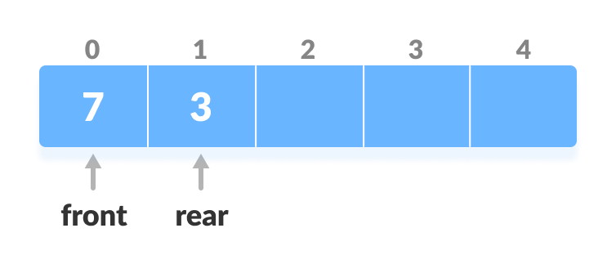
4. Delete from the Rear
This operation deletes an element from the rear.
1. Check if the deque is empty.
Check if deque is empty
2. If the deque is empty (i.e. front = -1), deletion cannot be performed (underflow condition).
3. If the deque has only one element (i.e. front = rear),
set front = -1 and rear = -1,
else (follow the steps below)
4. If rear is at the front (i.e. rear = 0)
rear = n - 1.
5. Else,
rear = rear - 1.
Decrease the rear

Slide 24
5. Check Empty
This operation checks if the deque is empty.
If front = -1,
the deque is empty.
6. Check Full
This operation checks if the deque is full.
If (front = 0 and rear = n – 1) OR (front = rear + 1)
the deque is full.

Slide 25
// Deque implementation in C
#include <stdio.h>
#define MAX 10
void addFront(int *, int, int *, int *);
void addRear(int *, int, int *, int *);
int delFront(int *, int *, int *);
int delRear(int *, int *, int *);
void display(int *);
int count(int *);
int main() {
int arr[MAX];
int front, rear, i, n;
front = rear = -1;
for (i = 0; i < MAX; i++)
arr[i] = 0;
addRear(arr, 5, &front, &rear);
addFront(arr, 12, &front, &rear);
addRear(arr, 11, &front, &rear);
addFront(arr, 5, &front, &rear);
addRear(arr, 6, &front, &rear);
addFront(arr, 8, &front, &rear);

Slide 26
printf("\nElements in a deque: ");
display(arr);
i = delFront(arr, &front, &rear);
printf("\nremoved item: %d", i);
printf("\nElements in a deque after deletion: ");
display(arr);
addRear(arr, 16, &front, &rear);
addRear(arr, 7, &front, &rear);
printf("\nElements in a deque after addition: ");
display(arr);
i = delRear(arr, &front, &rear);
printf("\nremoved item: %d", i);
printf("\nElements in a deque after deletion: ");
display(arr);
n = count(arr);
printf("\nTotal number of elements in deque: %d", n);
}

Slide 27
void addFront(int *arr, int item, int *pfront, int *prear)
{
int i, k, c;
if (*pfront == 0 && *prear == MAX - 1)
{
printf("\nDeque is full.\n");
return;
}
if (*pfront == -1)
{
*pfront = *prear = 0;
arr[*pfront] = item;
return;
}
if (*prear != MAX - 1) {
c = count(arr);
k = *prear + 1;
for (i = 1; i <= c; i++) {
arr[k] = arr[k - 1];
k--;
}
arr[k] = item;
*pfront = k;
(*prear)++;
}
else
{
(*pfront)--;
arr[*pfront] = item;
}
}

Slide 28
void addRear(int *arr, int item, int *pfront, int *prear) {
int i, k;
if (*pfront == 0 && *prear == MAX - 1)
{
printf("\nDeque is full.\n");
return;
}
if (*pfront == -1)
{
*prear = *pfront = 0;
arr[*prear] = item;
return;
}
if (*prear == MAX - 1)
{
k = *pfront - 1;
for (i = *pfront - 1; i < *prear; i++)
{
k = i;
if (k == MAX - 1)
arr[k] = 0;
else
arr[k] = arr[i + 1];
}
(*prear)--;
(*pfront)--;
}
(*prear)++;
arr[*prear] = item;
}

Slide 29
int delFront(int *arr, int *pfront, int *prear) {
int item;
if (*pfront == -1)
{
printf("\nDeque is empty.\n");
return 0;
}
item = arr[*pfront];
arr[*pfront] = 0;
if (*pfront == *prear)
*pfront = *prear = -1;
else
(*pfront)++;
return item;
}

Slide 30
int delRear(int *arr, int *pfront, int *prear)
{
int item;
if (*pfront == -1) {
printf("\nDeque is empty.\n");
return 0;
}
item = arr[*prear];
arr[*prear] = 0;
(*prear)--;
if (*prear == -1)
*pfront = -1;
return item;
}
void display(int *arr)
{
int i;
printf("\n front: ");
for (i = 0; i < MAX; i++)
printf(" %d", arr[i]);
printf(" :rear");
}
int count(int *arr)
{
int c = 0, i;
for (i = 0; i < MAX; i++)
{
if (arr[i] != 0)
c++;
}
return c;
}

